Slide 1
SPARK RDDs vs DATAFRAMES vs DATASETS
by SCB Team and Senthil

Slide 2
Overview
RDD
DATAFRAME
DATASETS
Compare and contrast
Conclusion

Slide 3
Introduction
Evolution of these abstractions happened in this way :
RDD (Spark1.0) —> Dataframe(Spark1.3) —> Dataset(Spark1.6)
RDD being the oldest available from 1.0 version to Dataset being the newest available from 1.6 version.
Each of the 3 abstraction will compute and give same results to user.
RDD lets us decide HOW we want to do which limits the optimisation Spark can do on processing underneath where as dataframe/dataset lets us decide WHAT we want to do and leave everything on Spark to decide how to do computation.

Slide 4
RDD:
Its building block of spark. No matter which abstraction Dataframe or Dataset we use, internally final computation is done on RDDs.
RDD is lazily evaluated immutable parallel collection of objects
But the disadvantage is performance limitations.

Slide 5

RDD example:
RDD example (live):

Slide 6
DATAFRAME:
DataFrame is an abstraction which gives a schema view of data.
Like RDD, execution in Dataframe too is lazy triggered.
Offers huge performance improvement over RDDs because of 2 powerful features.
Custom Memory management (aka Project Tungsten)
Optimized Execution Plans (aka Catalyst Optimizer)

Slide 7
Custom Memory management
Data is stored in off-heap memory in binary format.
Also there is no Garbage Collection overhead involved.
By knowing the schema of data in advance and storing efficiently in binary format.
Optimized Execution Plans
Query plans are created for execution using Spark catalyst optimizer. After an optimized execution plan is prepared going through some steps, the final execution happens internally on RDDs.

Slide 8
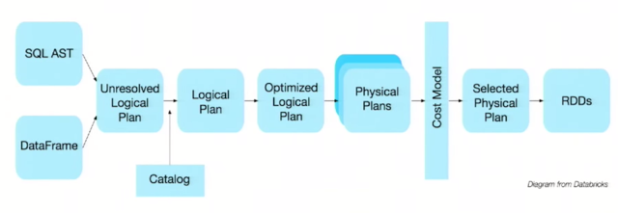


Slide 9
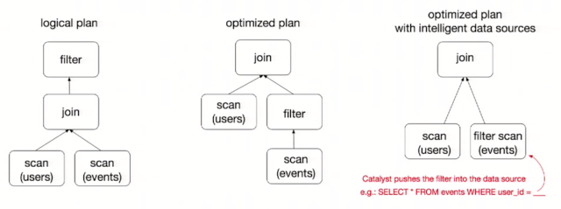

Slide 10
DATASET:
It is an extension to Dataframe API, the latest abstraction which tries to provide best of both RDD and Dataframe.
Comes with OOPs style and developer friendly compile time safety like RDD as well as performance boosting features of Dataframe : Catalyst optimizer and custom memory management.
Dataset has Encoders. Encoders act as interface between JVM objects and off-heap custom memory binary format data.
Encoders generate byte code to interact with off-heap data and provide on-demand access to individual attributes without having to de-serialize an entire object.

Slide 11
DATASET (contd):
case class is used to define the structure of data schema in Dataset.
Names of different attributes in case class is directly mapped to attributes in Dataset.
Dataframe is in fact treated as dataset of generic row objects. DataFrame=Dataset[Row] .
So we can always convert a data frame at any point of time into a dataset by calling ‘as’ method on Dataframe. e.g. df.as[MyClass]

Slide 12
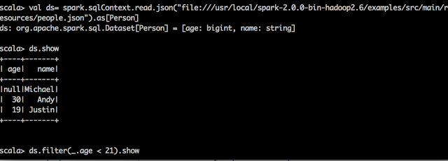
DATASET example :
DATASET example (live):

Slide 13
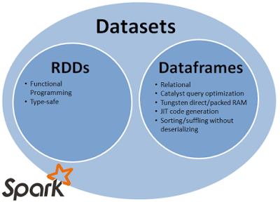

Slide 14
Compare and contrast:
As a Spark developer, you benefit with the DataFrame and Dataset unified APIs in Spark 2.0 in a number of ways.
Static-typing and runtime type-safety.
High-level abstraction and custom view into structured and semi-structured data.
Ease-of-use of APIs with structure.
Performance and Optimization.

Slide 15
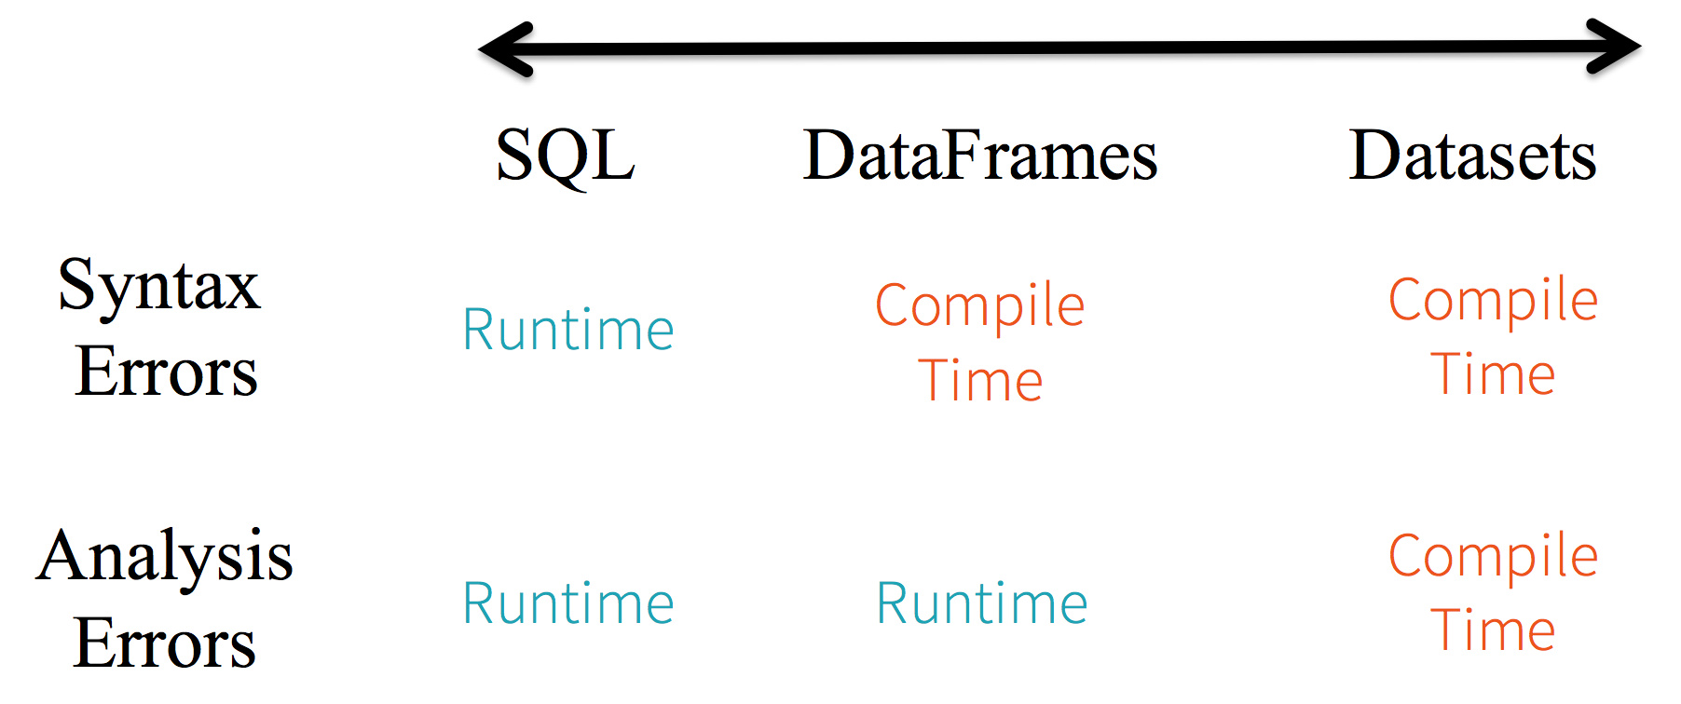
Static-typing and runtime type-safety:

Slide 16
In Spark SQL string queries, you won’t know a syntax error until runtime (which could be costly)
In DataFrames and Datasets you can catch errors at compile time (which saves developer-time and efficient)
However, it won’t detect a non-existing column name until runtime.

Slide 17
High-level abstraction and custom view into structured and semi-structured data:
DataFrames as a collection of Datasets[Row] render a structured custom view into your semi-structured data.
Three things happen here under the hood in the code above:
Spark reads the JSON, infers the schema, and creates a collection of DataFrames.
At this point, Spark converts your data into DataFrame = Dataset[Row], a collection of generic Row object, since it does not know the exact type.
Spark converts the Dataset[Row] -> Dataset[DeviceIoTData] type-specific Scala JVM object, as dictated by the class DeviceIoTData.

Slide 18
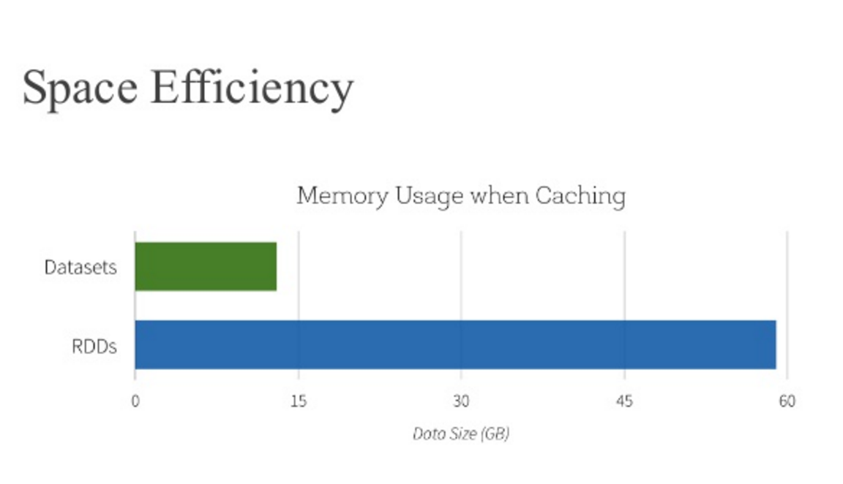
Performance and Optimization:

Slide 19
When should I use DataFrames or Datasets?
If you want rich semantics, high-level abstractions, and domain specific APIs, use DataFrame or Dataset.
If your processing demands high-level expressions, filters, maps, aggregation, averages, sum, SQL queries, columnar access and use of lambda functions on semi-structured data, use DataFrame or Dataset.
If you want higher degree of type-safety at compile time, want typed JVM objects, take advantage of Catalyst optimization, and benefit from Tungsten’s efficient code generation, use Dataset.
If you want unification and simplification of APIs across Spark Libraries, use DataFrame or Dataset.

Slide 20

Queries?

Slide 21

Thank you

